Slide 1


GHOUSIA COLLEGE OF ENGINEERING
RAMANAGARAM
Anudip foundation for social welfare
Project Seminar On
NETFLIX-CLONE
UNDER GUIDANCE OF,
VANISHA NAGESH K N
Submitted by,
Ameen Khan(AF04886948)
P H Usmaan Gani(AF04888147)
P Abdul Rasheed(AF04886983)
Sree Tilak C(AF04886945)

Slide 2
Introduction
Created a frontend clone of the Netflix homepage.
Built with HTML5 and CSS3.
Purpose: Learn modern layout techniques, styling, and structure.

Slide 3
Technologies Used
Technology | Use Case
HTML | Page structure
CSS | Styling and layout
Media Queries | Responsive design
Images/Videos | Visual content integration

Slide 4
Project Structure
index.html – Main HTML file
style.css – Linked CSS styles
img/ – Static assets like logo, thumbnails
videos/ – Embedded autoplay videos
js/script.js – (Linked)

Slide 5
Key Features
Hero section with background image and CTA
Multiple content sections with visuals
Language dropdown and sign-in button
Accordions for FAQs
Fully responsive layout

Slide 6
Responsive Design
Layout adapts across:
Desktop
Tablet
Mobile
Achieved using:
Flexbox
CSS media queries
Column ordering

Slide 7
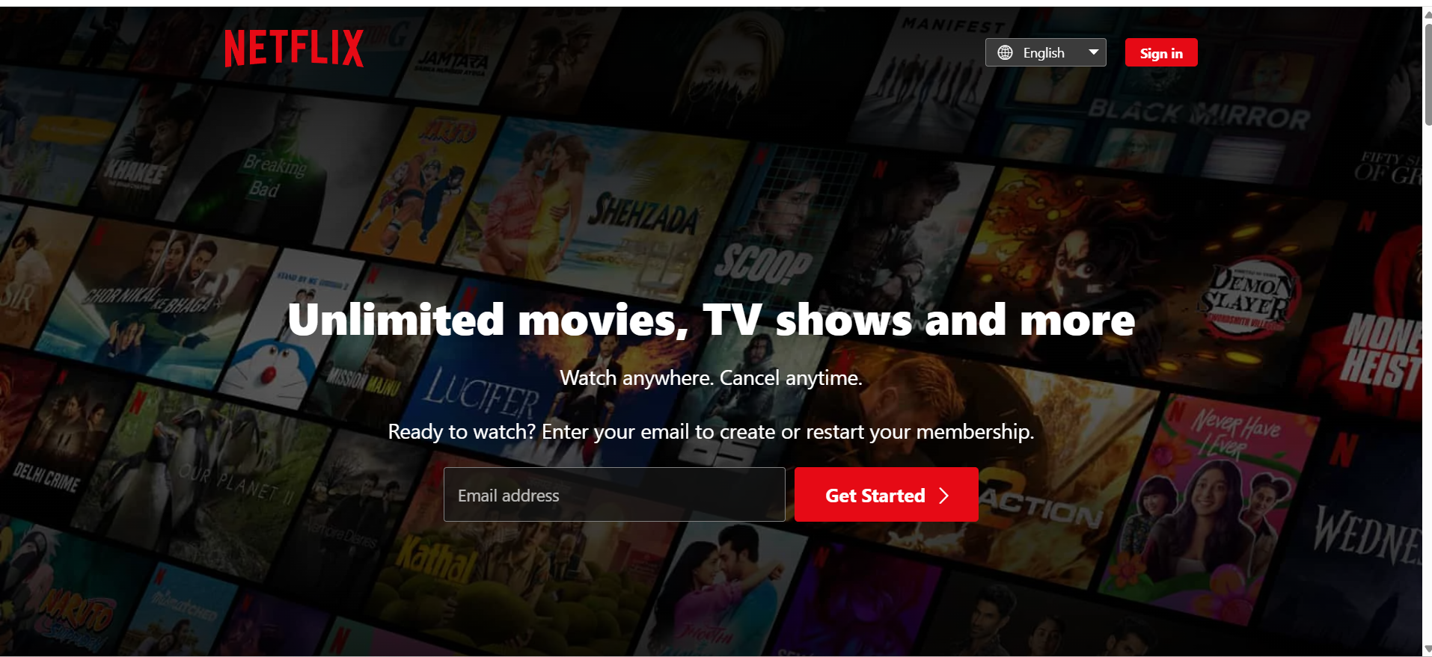
Snapshots
Header & Navbar

Slide 8
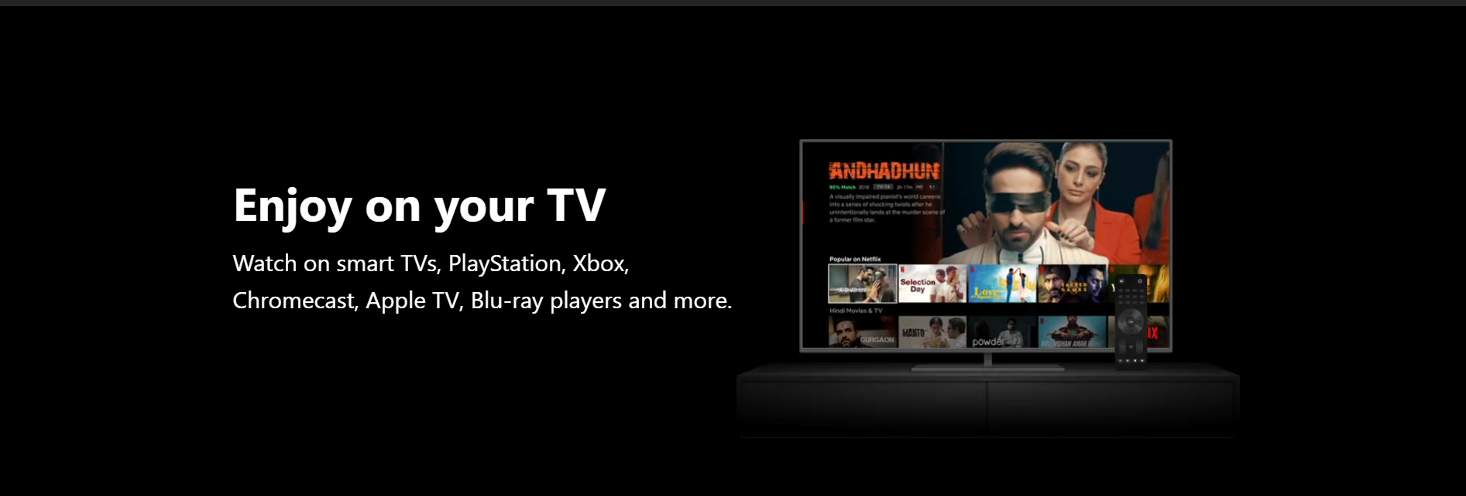
Snapshots
Hero Banner

Slide 9
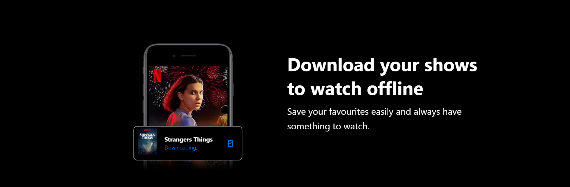
Snapshots
Download feature section

Slide 10
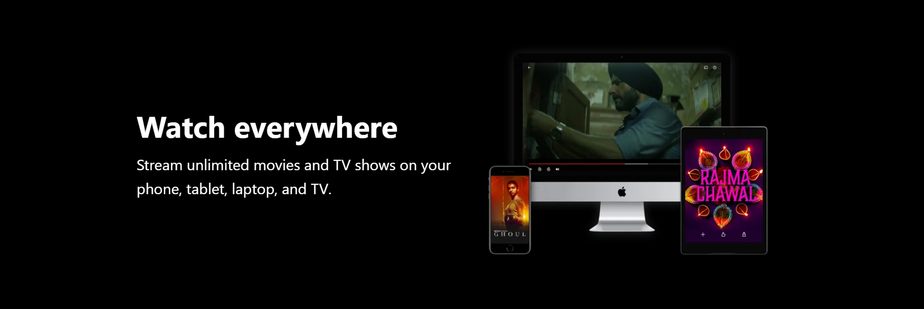
Snapshots
Enjoy on TV section

Slide 11
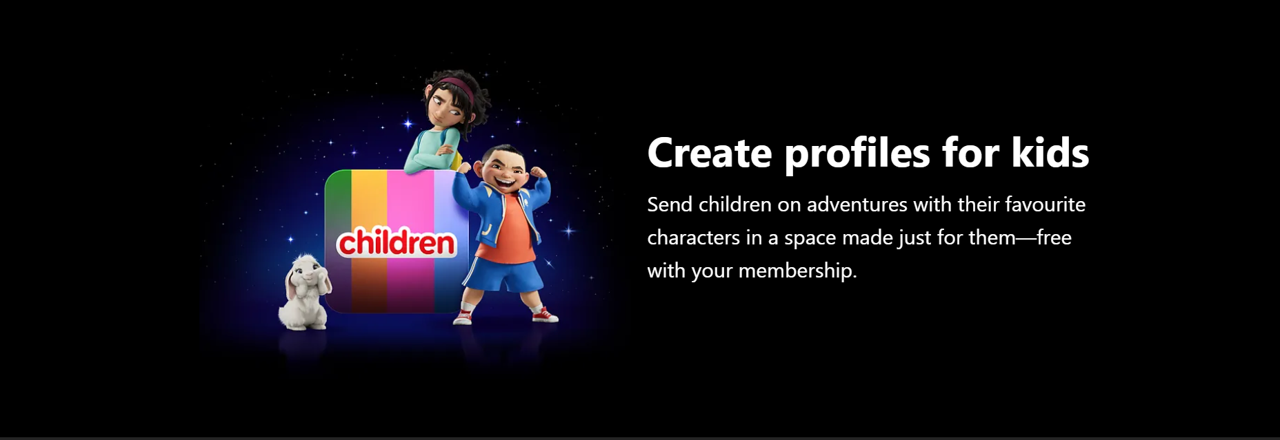
Snapshots
Switching profiles kids/adult

Slide 12
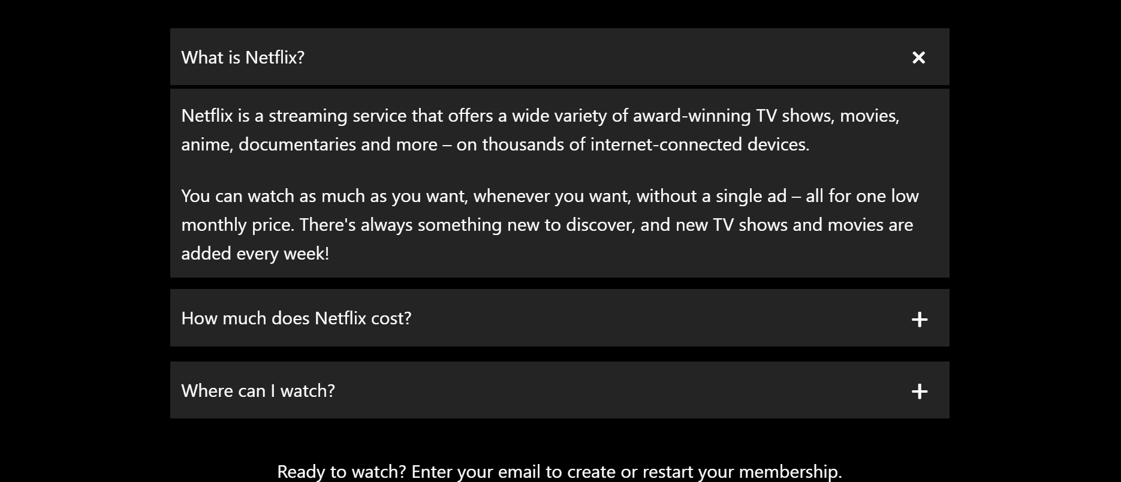
Snapshots
FAQ accordion

Slide 13
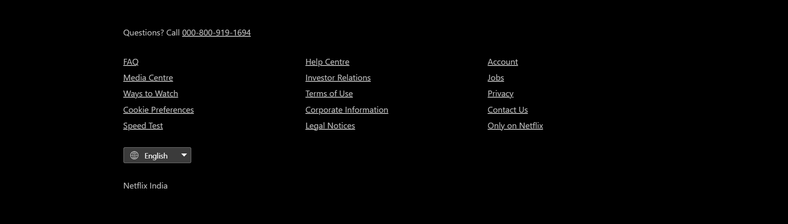
Snapshots
Footer

Slide 14
Challenges Faced
Video and image positioning together
Consistent responsive behavior
Accordion styling without JavaScript (static layout)

Slide 15
What I Learned
Building layout with HTML/CSS from scratch
Managing file structure for assets
Creating a pixel-perfect clone
Writing clean, responsive CSS

Slide 16
Future Improvements
Add interactive JavaScript for accordion
Lazy-load images and videos
Deploy live using GitHub Pages or Netlify

Slide 17


